Slide 1

DevOps 4 webMethods.io Integration

Slide 2

DevOps 4 webMethods.io
AGENDA
webMethods.io IPaaS
DevOps Requirement & Benefits
Context
Use case Overview
GIT Workflow
Delivery / Deployment Overview
Implementation to Delivery Flow
Demo
Scope, Assumptions & Pre-requisites
Demo

Slide 3


webMethods.io iPaaS
Integration, B2B, MFT and API Management
MULTI-FUNCTION iPaaS
API
for LOW-CODE and HIGH-CONTROL developers deployed across a MULTI-CLOUD infrastructure
Cloud and Hybrid Connectivity
Orchestration
Guided development
Recipes
Monitoring
B2B
INTEGRATION
MFT
Notes:
webMethods.io iPaaS is the only integration platform-as-a-service that delivers all required capabilities. The unique combination of API management, hybrid integration, application integration, data integration, microservices and IoT integration in one platform.
Market leader in API Management*
300+ field tested connectors to accelerate implementation without coding
The only platform empowering you to integrate anything—anywhere!
Key Points:
1. Promotes accelerated integration for all types of users from technology professionals to empowered business analysts
2. Combines integration, API management, and B2B in the cloud and on premises; unified runtimes enable seamless integration
3. Delivers freedom to innovate with a standards-compliant independent platform

Slide 4



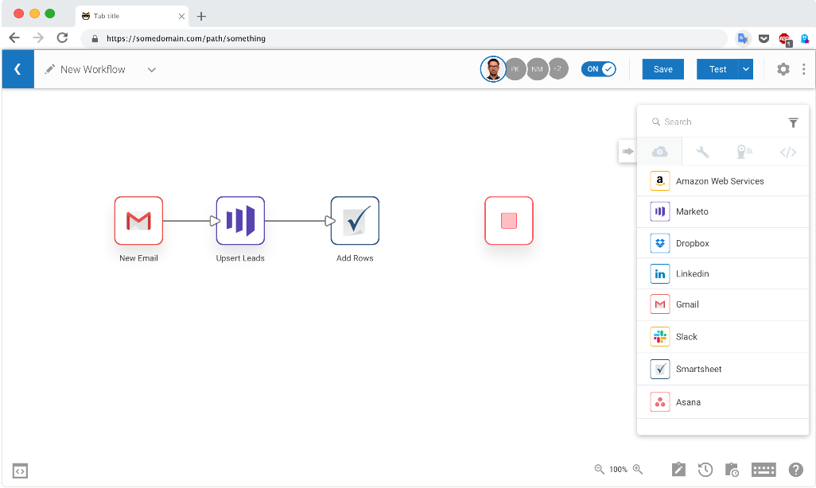

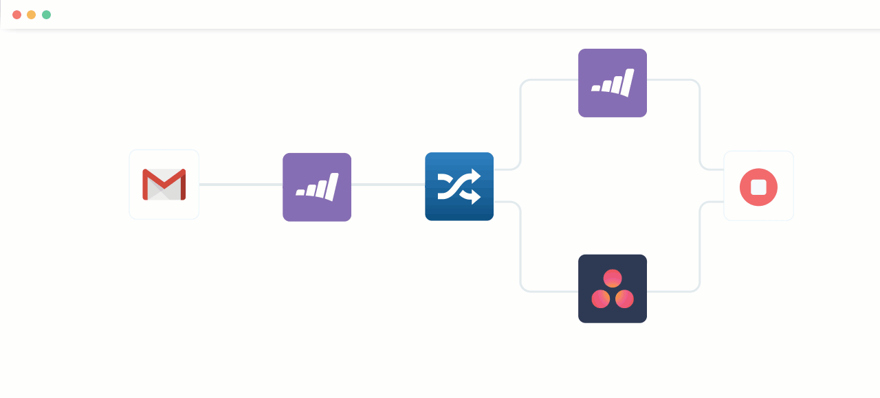

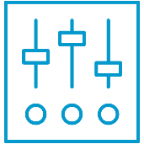
webMethods.io Integration
Quickly integrate applications in the cloud
Rapid Workflow Development
Extensive Connectivity Toolkit
Broad
Developer Support
Optimized for Scale and Performance
Notes:
We have a UI that developers fall in love with from the minute they start to use it due to its simplicity, ease of use, yet providing significant power!
Reliable Hybrid Connectivity: Manage hybrid portfolios with applications or data which are located both on-premises and in the cloud
Extensive Connectivity Toolkit: Connectivity options for the most popular SaaS application and a workflow toolkit for every modern protocol or need
Broad Developer Support: Democratize your integration projects across the organization. Reduce your integration backlog by building intuitive workflows, quickly
Optimized for Scale and Performance: Performant service architecture ensures your most critical integration workflows run with confidence. With dependable monitoring and reporting

Slide 5
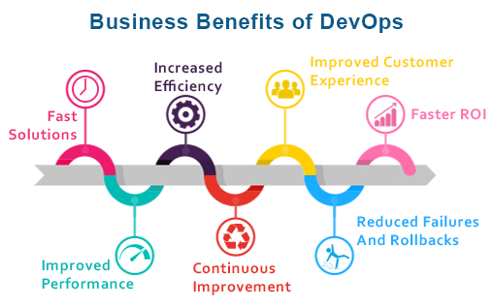
DevOps Requirement & Benefits
Faster release rate, hence faster “to Market”
Fault Isolations
Faster Mean Time To Resolutions (MTTR)
Test Repeatability and Reliability
Greater visibility into system outcomes
Notes:
MTTR measures the maintainability of repairable features and sets the average time to repair a broken feature. Basically, it helps you track the amount of time spent to recover from a failure.
CI/CD reduces the MTTR because the code changes are smaller and fault isolations are easier to detect. One of the most important business risk assurances is to keep failures to a minimum and quickly recover from any failures that do happen. Application monitoring tools are a great way to find and fix failures while also logging the problems to notice trends faster.

Slide 6
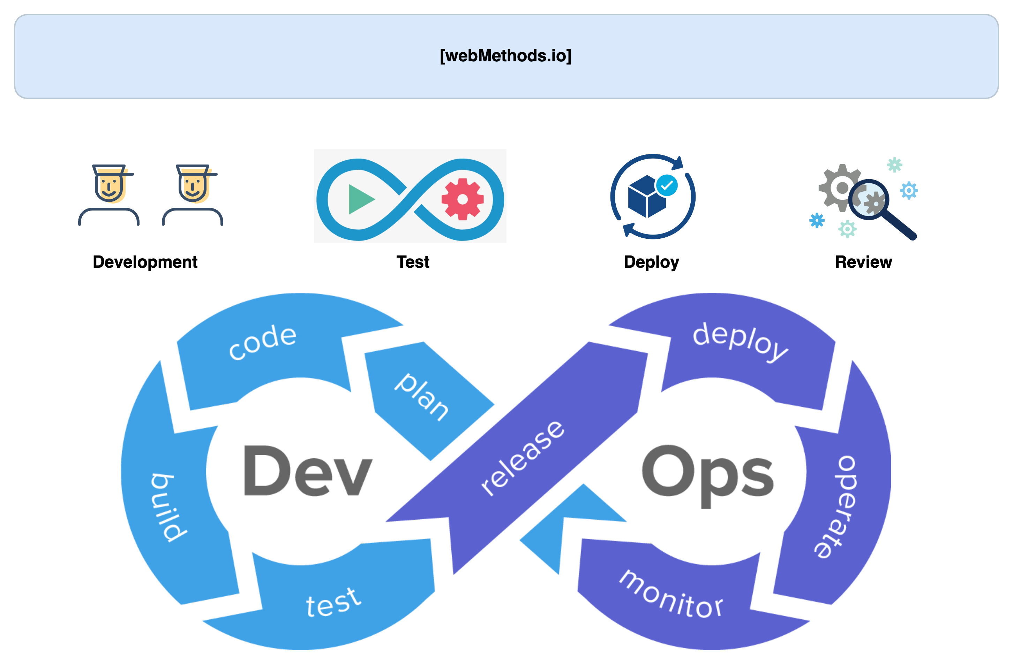
Context
Context & Background
Flexible Development Process
Code Quality Check
Automated Testing
Delivery / Promotion Automation
Repeatability

Slide 7
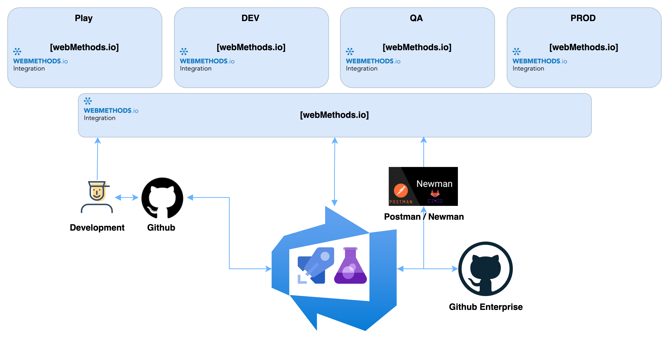
Context
Platform & Tools
Below are the assumptions made for further discussions
4 Environments
Play/Build, Dev, QA and Prod
Automation / Orchestration platform
Azure DevOps
Test Automation
Postman / Newman / Azure Test Plan

Slide 8
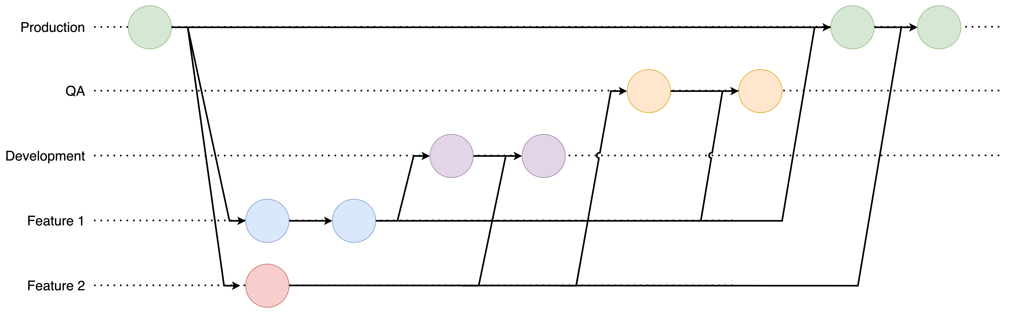
Use case Overview
GIT Workflow
Note: This is just a sample model used by one of the customer where the solution was primarily developed. This
framework can be adopted to any Git Workflow used by customer as per their needs. We are not promoting any specific
model.

Slide 9
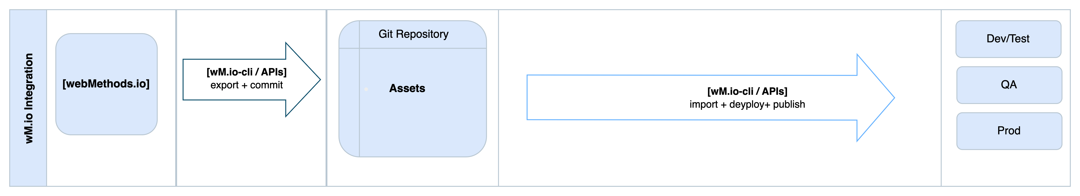
Use case Overview
Delivery / Deployment Overview

Slide 10
Use case Overview
Implementation to Delivery Flow

Slide 11
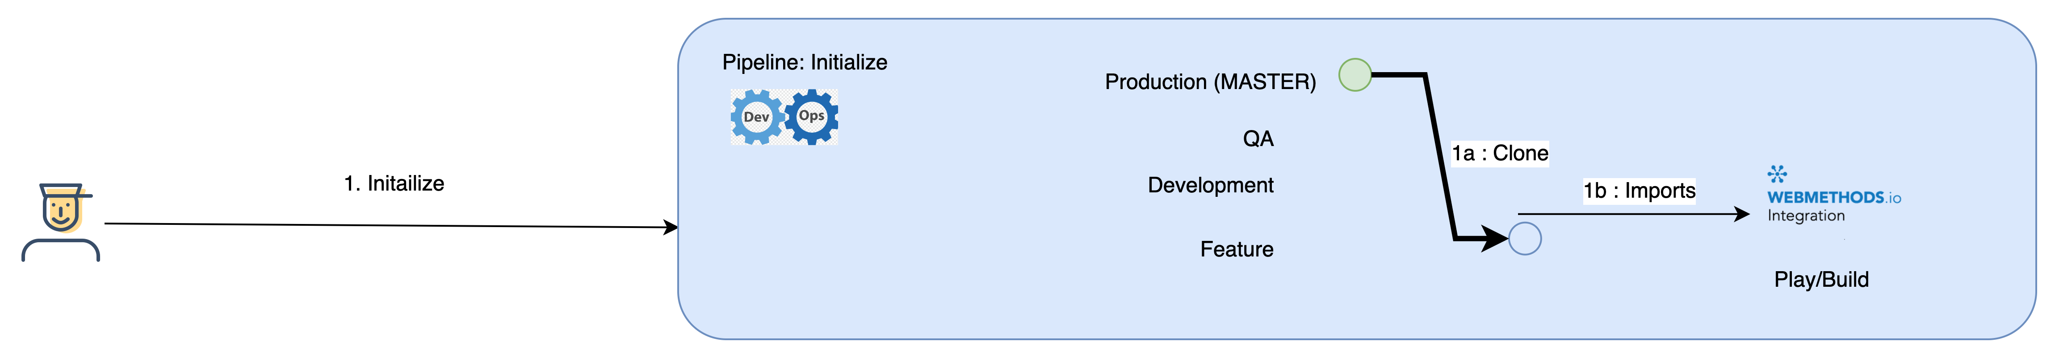
Use case Overview
Implementation to Delivery Flow : Implementation
Developer starts by executing Initialize Pipeline (Automation)
This checks if the request is for an existing asset or a new implementation
If new, automation will
Initialize a repository
Create standardized branches, including requested Feature Branch
Create a project in Play/Build environment
If existing, automation will
Clone the Prod branch to Feature branch
Import asset to Play/Build environment

Slide 12
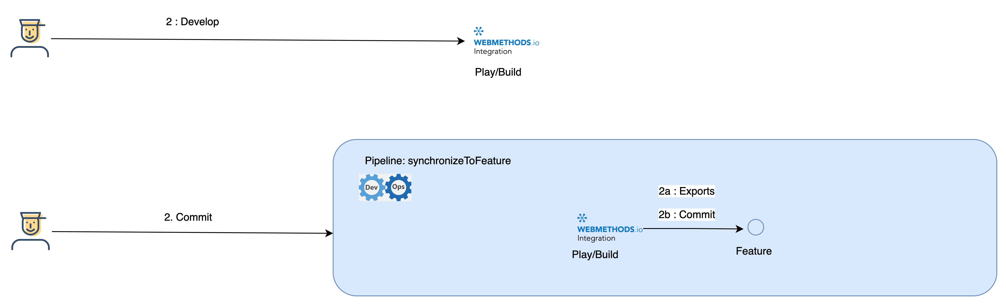
Use case Overview
Implementation to Delivery Flow : Implementation
Developer starts developing
Once after completion he will execute synchronizeToFeature Pipeline (Automation)
Automation will
Export the asset
Commit the asset to Feature Branch

Slide 13
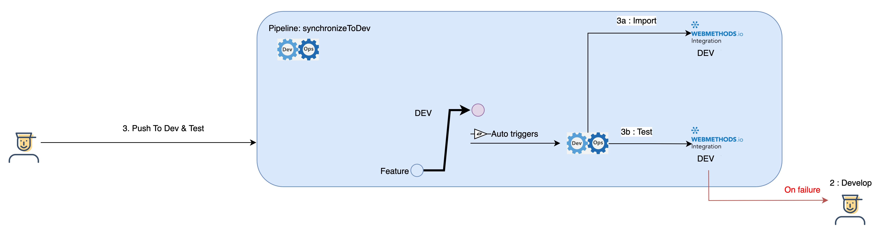
Use case Overview
Implementation to Delivery Flow : Delivery DEV
Once the implementation is finished, developer manually creates a Pull Request from Feature Branch to DEV.
This will trigger the synchronizeToDev pipeline (Automation)
Automation will
Checkout the DEV branch
Import the asset to DEV environment
And then kicks of automated test for the associated project/repo with data/assertions specific to DEV
On Failure, developer needs to fix/re-develop the asset (Step 2).

Slide 14
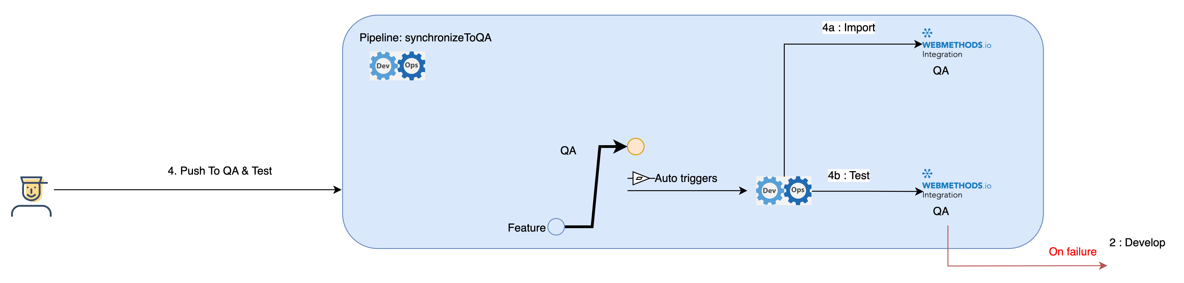
Use case Overview
Implementation to Delivery Flow : Delivery QA
After Dev cycle is complete, developer manually creates a Pull Request from Feature Branch to QA.
This will trigger the synchronizeToQA pipeline (Automation)
Automation will
Checkout the QA branch
Import the asset to QA environment
And then kicks of automated test for the associated project/repo with data/assertions specific to QA
On Failure, developer needs to fix/re-develop the asset (Step 2).

Slide 15

Use case Overview
Implementation to Delivery Flow : Delivery PROD
Once the automated test and UAT is successfully finished, developer manually creates a Pull Request from Feature Branch to PROD. PROD deployment may have different approval cycle.
Respective operations team will manually trigger the synchronizeToPROD pipeline (Automation)
Automation will
Checkout the PROD branch
Create a release
Import the asset to PROD environment
And then kicks of automated Smoke test, if any for PROD.
On Failure, developer needs to fix/re-develop the asset (Step 2). And release will be rolled back.

Slide 16

Show & Tell / Demo

Slide 17
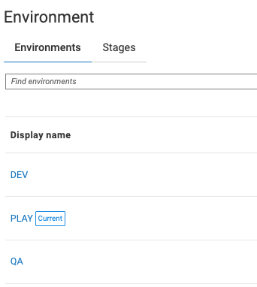
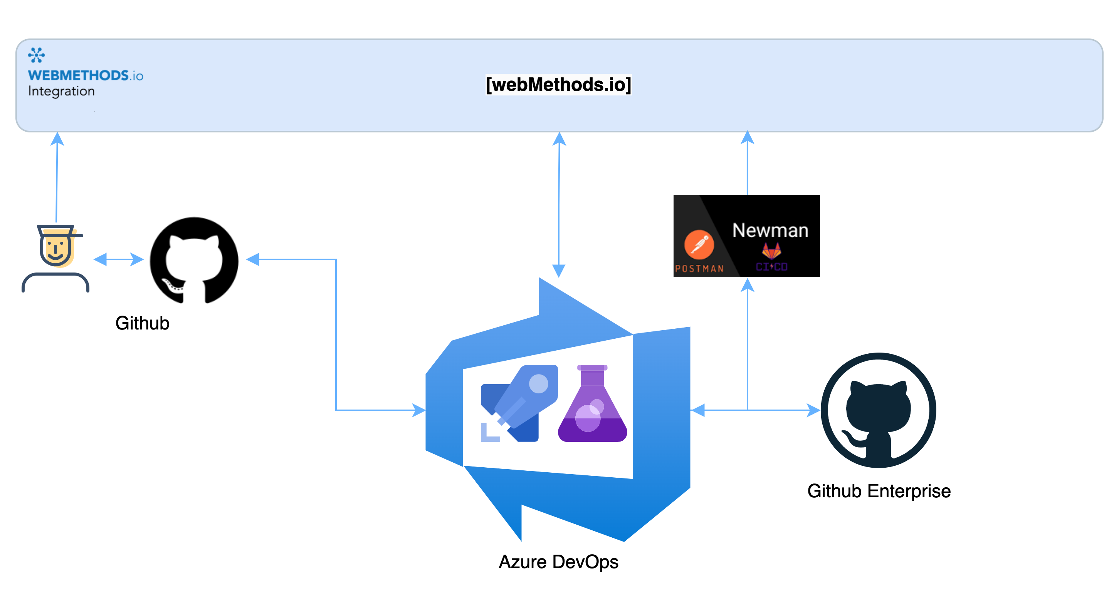
Demo
Scope, Assumptions & Pre-requisites
3 Environments
Play/Build, Dev & QA
Assets used for demo
2 Workflows (one with Sub FS), 1 Flowservice, Reference Data, Account (Only export), Project Parameters.
Automation / Orchestration platform
Azure DevOps
2 Repository Platforms
Github Enterprise for Pipelines/Scripts (Automations)
Github for actual webMethods IO assets
Test Framework
Postman / Newman & Azure Test Plans

Slide 18
Demo
Demo
Notes:
Cleanup
Initialize
Show Structure
Talk about Git Workflow
Import/develop
WF
Flow
Ref
Accounts
Test
WorkflowID
Flowservice http flag
Mention and show (Tests could be triggered separately as well)
GitHub
Action
Key
SynchToFeature
Show Repo
Talk about structure
Reference Data/ config structure
Update DEV and QA configs
Show test results
Pull feature to DEV
Show the Dev Branch
Show Action/Workflow in Github
Show Azure
DEV triggered
Test results (falied)
Show DEV Tenant
Project
Workflow1
Webhook, Subflow
Workflow 2
Account not created
No Trigger
FS
Flag
Configs
PP
Ref Data
Update DEV Branch
Test:
Repo workflow id
Enable http
Rerun Manually DEV Test
Show Results
Pull feature to QA
Show tenant
Ref Data

Slide 19

What Next

Slide 20
Next Steps
Extend & Expand
More connector tests
Integration with Hybrid DevOps
Test Coverage
Code Review

Slide 21
Next Steps
Features
Project Export/Import
Account Export/Import
Direct Git Integration (Origin)
Multiple runtime support (Origin)

Slide 22
References
Repository for automation, scripts & sample assets: https://github.com/IBM/webmethods-io-int-cicd
API Documentation: https://docs.webmethods.io/integration/apis/webmethods_api_ref/#reference-data-apis
CLI Repository: https://github.com/SoftwareAG/webmethods-io-integration-apicli

